Slide 1

Improving Movie Recommendation System by grouping users
Presented By: Rohit Sharma and Avineet Kumar Singh
University of South Carolina
CSCE-883

Slide 2
Background
Existing Movie Recommendation System use:
Content Based methods
Collaborative filtering methods
Hybrid model
Grouping Users
Cosine Similarity
Undirected connected graph (network analysis)

Slide 3
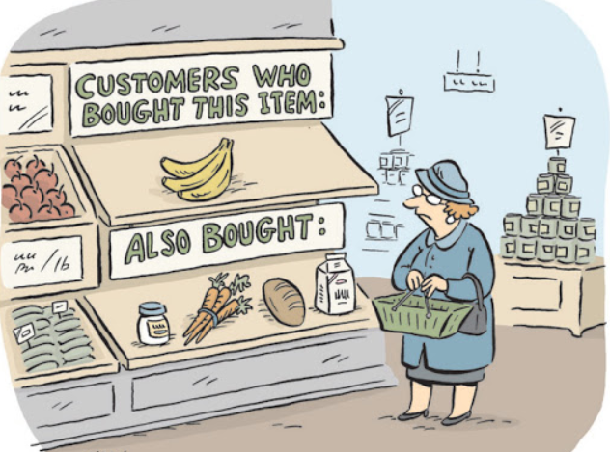
Problem
Existing methods compared similar users and recommended movies.
Or used similar movies to recommend new movies.
This created a less accurate recommender system.
Had a cold-start problem.

Slide 4
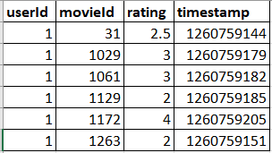
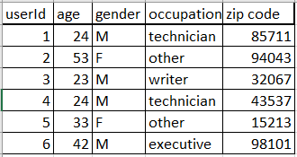
Dataset
Dataset: Movie Lens
Ratings for 1682 movies given by 943 users
Most of the movies have received less than 50 ratings

Slide 5
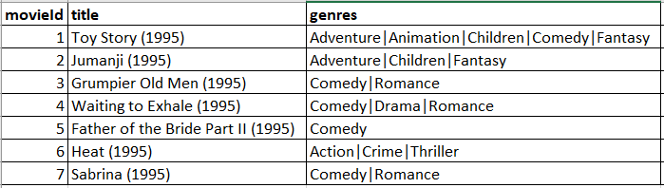
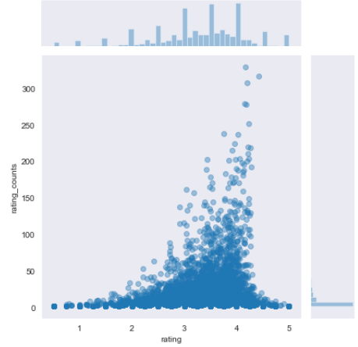
Dataset
Dataset: Movie Lens
Each user provided ratings to at least 20 movies.
Fig: Average ratings against number of ratings.

Slide 6
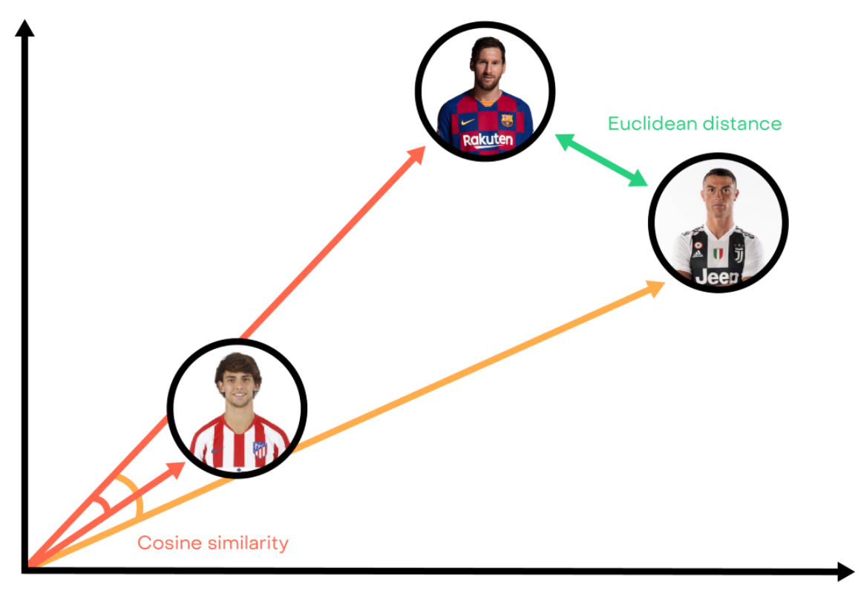
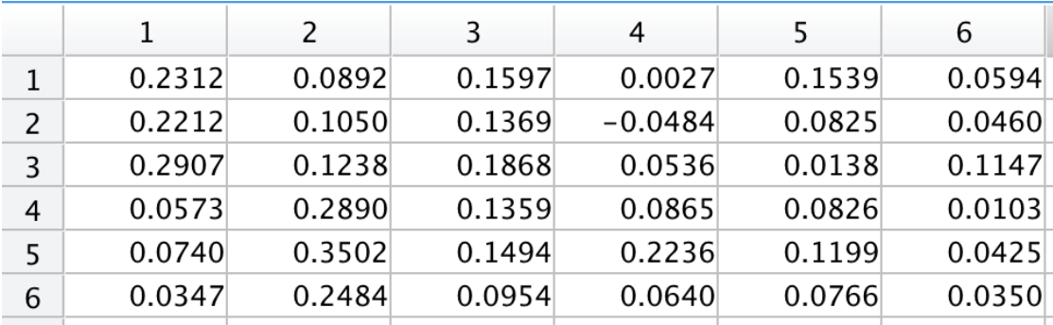
Cosine Similarity

Slide 7
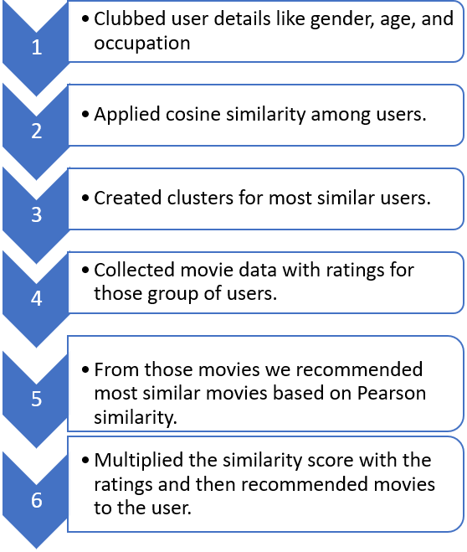
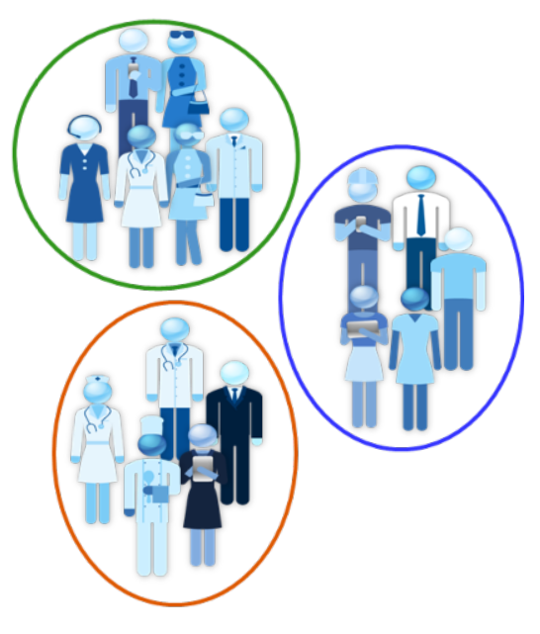

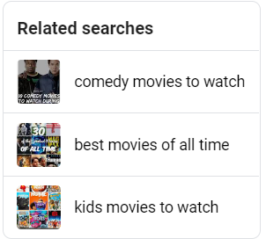

Approach: 1

Slide 8
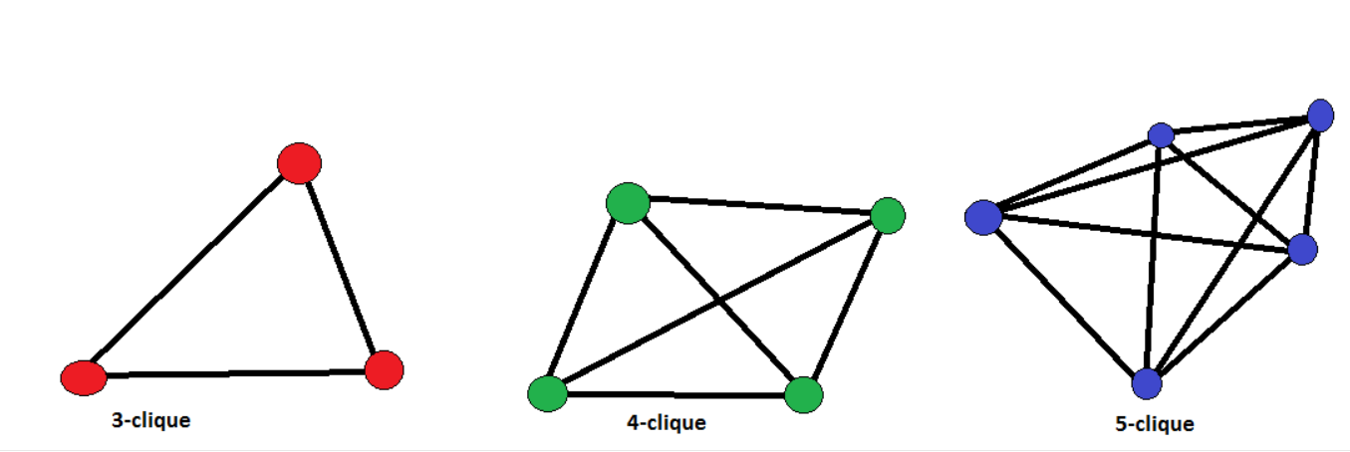
Undirected connected graph

Slide 9

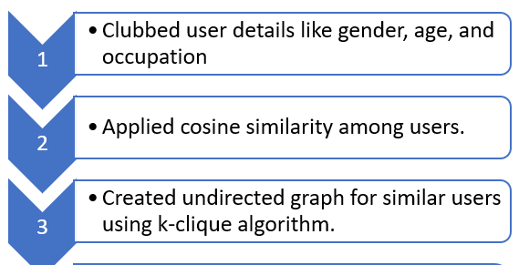

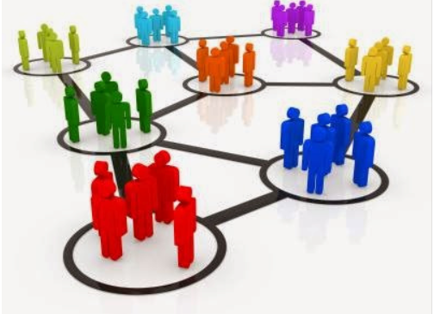
Approach: 2 (Improved)

Slide 10
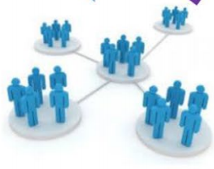

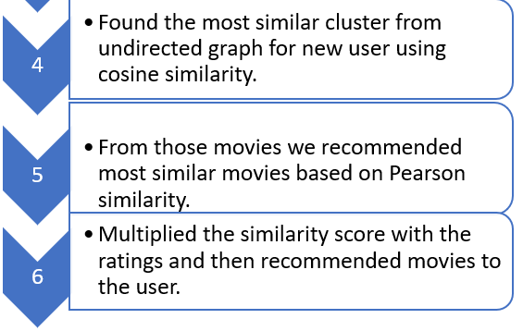
Approach: 2(Improved)

Slide 11

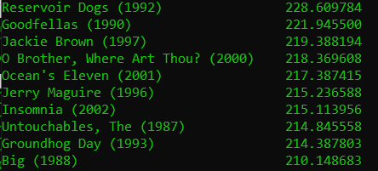
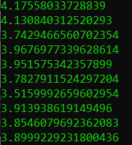
Results
Approach 1:
For UserId: 943
Users who rated more than 50 movies.
Recommended Movies Total Score Predicted Rating

Slide 12
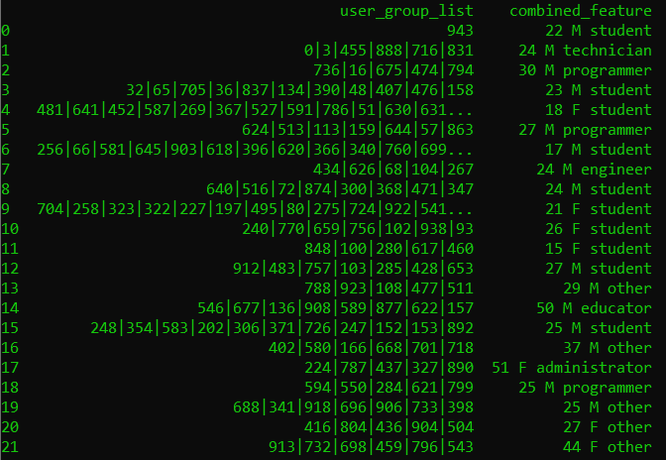
Results
Approach 2:
For UserId: 943
User Cluster using Unconnected Graph with size greater than 5.

Slide 13
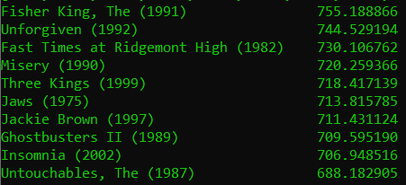
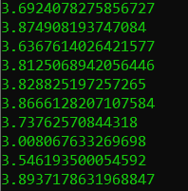

Results
Approach 2:
For UserId: 943
Users who rated more than 50 movies.
Recommended Movies Total Score Predicted Rating

Slide 14

Future Work 1. Add demographics information 2. Include personality data by collecting user information. 3. Based on user login time.

Slide 15
References
Dataset: https://grouplens.org/datasets/movielens/latest/
An Exploratory Study of Collaborative Filtering Vs. Content Based Movie Recommendation by Dr. Kumud Kundu, Rahul Pandey , Pankaj Bhatt, Rahul, Riya kakar.
Item Based Collaborative Filtering Approach in Movie Recommendation System Using Different Similarity Measures by Jamilu Maaruf Musa and XU Zhihong .

Slide 16


